Slide 1
Solving the correspondence problem in an unstructured, unmapped environment
Jc Kriel 32738889
Brief touch on risks before timeline!
Write basic root on slides, explain slides but no need for complex script
Rephrase to use less technical language, approachable to most on the Aero course or a grand parent
EG “improving positioning in unstructured, low infrastructure envornment”
Story telling: What am I doing -> Why am I doing -> How am I doing
Add platform image somewhere!!! Images available on oceanperception.com!
Add risk list? Slide
Impact, show target area of research Lidar -> object idenfication

Slide 2
Determining effective algorithms for feature reidentification in an unordered, unmapped environment
Jc Kriel 32738889

Slide 3
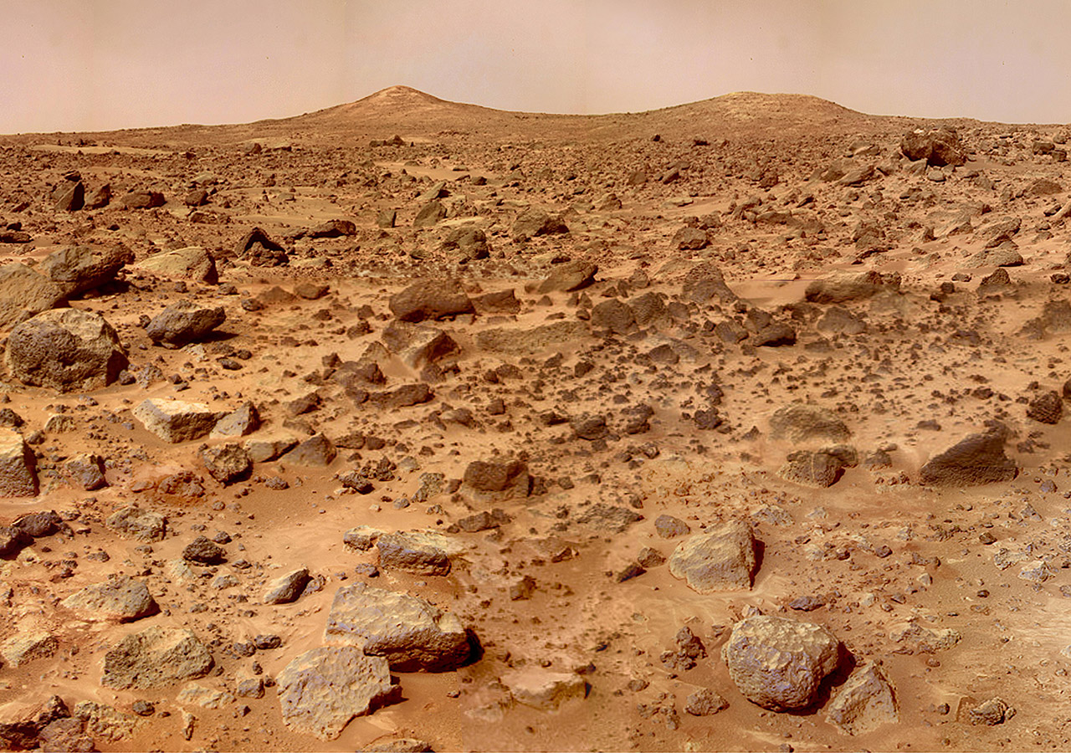
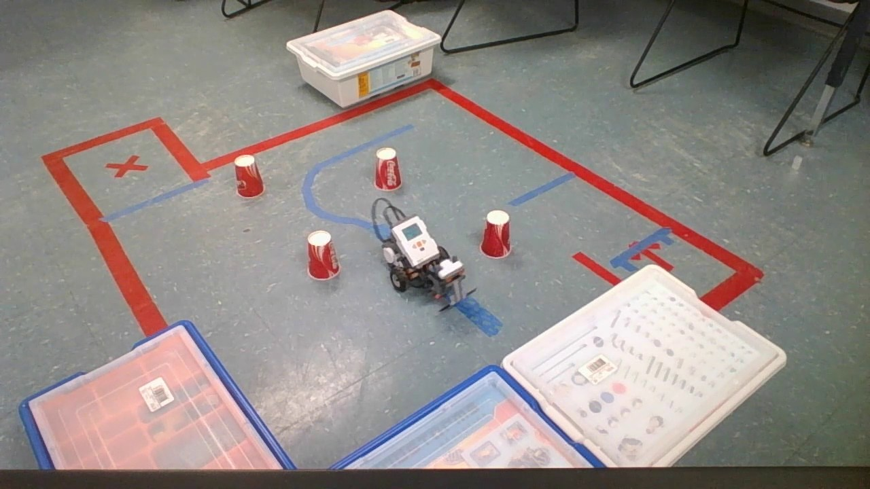
Localisation problem - context
Autonomous robots need to know where they are to perform tasks, how can we achieve this with no GPS?
Instead of detail on Lidar or “the beacon idea”: Focus on normal operation and WHY this isn’t applicable in my operating environment
Natural shapes have unpredictable shapes making identification horrible -> FOCUS on correspondence problem, demonstrate “need repeate identification for identification of position!”
LIDAR - demonstration
Operating environment
Operating environment
Objects are distinct and sparse
Reidentification of the same object simplified
High information environment
Objects lack distinctive features
Can’t localise from objects without corresponding sightings accurately
Find other similar image if needed: https://theflighter.com/nasa-mars-pathfinder-twin-peaks/
Source: https://en.wikipedia.org/wiki/File:LIDAR-scanned-SICK-LMS-animation.gif

Slide 4
Localisation problem - context
Autonomous navigation without GPS
LIDAR - demonstration
Typical setting
Surface of mars
Source: https://en.wikipedia.org/wiki/File:LIDAR-scanned-SICK-LMS-animation.gif

Slide 5
Script notes, Localisation (Delete later)
How do we localise? Fundamentally we always do so using relative positions to landmarks, take a known location -> figure out our position relative to it -> we know our location.
GPS runs on this principle, but in extreme environments (underwater, mars, moon ect) our access to such tools are limited or non-existent
SLAM (Simultaneous localization and mapping) simply means to construct a map of an unknown environment and use that map for navigation while expanding it, humans do this without even thinking about it
Built environments have distinctive features to localise off, take the scene (image) any of these rocks look distinctive
For localisation to work we need to be able to correspond a reading with its related object OR create a new object.
This project will be using a tilted LiDar sensor as it’s input as that’s a common tech and it’s lessons are cross applicable (sonar, radar)

Slide 6
AIM
Remove the first AIM since it’s basically a objective for AIM 2, then change AIM 2 to be more reflective of the TITLE (something around correspondence problem in SLAM in natural environments)
Investigate the challenges confronted by contemporary Simultaneous Localization and Mapping (SLAM) methodologies in intricate natural environments rich in information, specifically when constrained by the usage of single-plane tilted LIDAR technology
Determination of which methods are most suited for mapping and localisation when attempting autonomous navigation in an unstructured, unmapped environment.
Alt: Examine and identify optimal methodologies for mapping and localization in the context of autonomous navigation within unstructured and unmapped environments.

Slide 7
Script notes, AIM (Delete later)
AIMs summerise context
First point is about doing further research into specific problems SLAM faces in the outlined environments and related research on solutions. Filtering out material that cannot be applied to my setup.
Evaluation of the effectiveness of applicable solutions. Dependent on AIM 1

Slide 8
Objectives
Potentially add “impact” slide??
Reduce this to be 4 Bullet points (Identification, Implementation (Simulation and Experiment), Evaluate)
Potentially insert image for showing corresponance in LIDAR vision
Why do I NEED simulation and experiment
Key point is IMPLEMENTING SLAM SOLUTION
Remove literature review from objectives, change to something like “identify suitable SLAM frameworks”, “identify the suitability of established SLAM frameworks”
Literature review
Investigation of difficulties facing current SLAM methods in messy high information natural environment
Investigation of potentially applicable SLAM methods
Error checking algorithm investigation (quantifiable success measurement)
Assumptions
Robot would be able to avoid impassable obstacles
Ground level can be approximated as flat
Simulation
Construct a simulation of the environment and robot
Measure the effectiveness of selected methods at successful navigation and mapping, under various levels of sensor accuracy and environmental complexity.
Experiment
Setup scenario’s similar to key simulations and compare accuracy
Move assumptions to beginning (challenge explanation) to show why I’m only focusing on THIS (“correspondence problem”) part of the problem (explaining transition from TITLE -> AIM)

Slide 9
Script notes, Objectives (Delete later)
Achieving the first AIM requires a literature review for:
Specification of problems and solutions
Research into methods of quantifying the success of different approaches so that AIM 2 can be achieved
To achieve AIM 2 data on effectiveness must be gathered, this is to be achieved through simulation and experimentation. Time and resource constraints will limit the number of strategies that can have detailed analysis performed so only the most promising will reach simulation and experimentation.
Experimentation can be used to validate/improve the simulation, in a simulation we have perfect understanding/control of the environment making it ideal for testing algorithms over a large range of scenarios.
The purpose of this IP isn’t to solve path finding issues
Experiments will be done in a way such that active path finding isn’t required
The sensor is very limited and including ground elevation greatly complicates the project, research is still reasonably applicable to general applications especially in environments with very gradual changes in elevation (flat)

Slide 10
Timeline
Draw up better plan with dates and potential interruptions (exams)
Put into gnat chart
Literature review and project plan
Simulation and experiment planning
Determination of set of algorithms which can be practically implemented
Determination of simulation method
Initial simulation testing
Interim report
Finalise first set of simulations
Choose scenarios for experimentation and use those to iterate on simulations
Final report draft, final report and poster day

Slide 11
Script notes, Timeline (Delete later)
Rough overview of timeline, further detail will require a literature review

